Slide 1
Demand Analysis of Beer Consumption in the U.S.
Olga Murova
Benaissa Chidmi
Texas Tech University

Slide 2
Research Objectives
Determine U.S. consumers preferences of domestic vs imported beer
Name specific socio-demographic factors that contribute to this preference
Determine consumers’ preferences for a set of categories of domestic and foreign beer
Notes:
The objective of this research is to determine if there is a bias that exists among the U.S. consumers of domestic versus foreign beer and to examine consumers’ attitude toward different product alternatives (categories) within each group.
Beer is losing its lead of the alcohol market share to wine, however it still sells huge volumes. Even a non-beer drinker is able appropriately guess the top five bestselling domestic beers, which are Bud Light, Budweiser, Coors Light, Miller Light, and Natural Light (Anheuser-Busch). Among the top five import beers sold in the U.S. are Corona Extra, Heineken, Labatt Blue, Tecate, and Guinness (Professor’s House, 2014).
One of the specific objectives of this research is to look at the consumers of beer as a group and determine if they prefer domestic beer over foreign beer. Second objective is to name based on the statistical evidence specific factors that determine consumers’ attitudes toward preferring alternative products among domestic and among foreign beers.

Slide 3
Literature on beer demand
B. Lee and V. J. Tremblay, 1992, “Advertising and the US market demand for beer”, Applied Economics, 24, 69-76.
The most important determinants of demand are the price of beer, the price of substitutes (whiskey and cola drinks), demographic factors, and the light beer dummy variables, demand for beer is relatively inelastic
Disadvantage: constrain the price and income elasticities to be constant
F.S. Koppelman and C.H.Wen, 1998, “Alternative nested logit models: structure, properties and estimation”, Transportation Research, Vol. 32, 5, 289-298.
The multinomial logit (MNL) model (McFadden, 1973), the most widely used discrete choice model, is based on principles of utility maximization
Advantages: independence of irrelevant alternatives (IIA), simple structure and ease of estimation
The most widely known relaxation of the MNL model is the nested (NL) or hierarchical (HL) logit model which allows interdependence between the pairs of alternatives in a common group (McFadden, 1978; Ben-Akiva and Lerman, 1985; Boersch-Supan, 1990a).
The non-normalized nested logit (NNNL) by Daly (1987), which is identical to the McFadden model except that the model does not include the inverse of each logsum parameter in the utility function of the alternatives in the corresponding nest
Nor consistent with utility maximization
Notes:
1. Lee and Tremblay used double log functional form to run 2 regressions – double log and saturation model (where real disposable per capita income was used as (-1/M) .
2. Two distinctly different nested logit models have been widely used in both research and applications. The differences, not widely recognized, between these models will substantially influence estimation results, behavioral interpretation and policy analysis. The McFadden nested logit model is derived from random utility theory; the Daly or non-normalized nested logit model is based on probability relationships and is not consistent with utility maximization.
The multinomial logit (MNL) model (McFadden, 1973), the most widely used discrete choice model, is based on principles of utility maximization and has the advantages of simple
mathematical structure and ease of estimation.

Slide 4
Data – The IRI Academic Data Set (Kruger and Pagni)
Data on purchases of beer 2011 (17205 observations)
Six categorical variables are used:
Household income
Type of residence
Age
Education
Profession
One continuous variable - amount of purchase
Notes:
The IRI Academic Data Set collected by M.W. Kruger and D. Pagni is used in this research. This data set is a marketing survey of store sales and consumer panel data for 30 product categories. Current study uses only data on beer for the year 2011. A final set of files contain demographic and economic characteristics of consumers, a list and description of purchased products, prices, and stores where products were purchased.
Four variables are used as an explanatory variables in the logistic model: hhincome, family size, type of residence, price of purchased beer. First three variables are categorical variables and amount spent is a continuous variable. Hhincome is represented by 12 categories, type of residence has three categories (1=renter, 2= owner, 3 = unknown), and

Slide 5
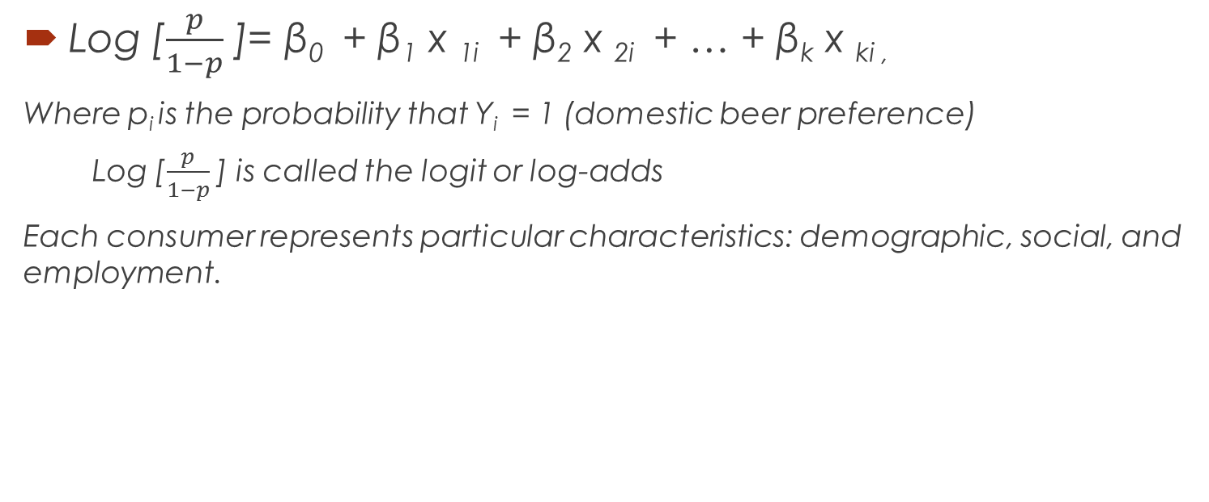
Probability of preference of domestic beer vs imported
Log [$\frac{p}{1−p}$ ]= β₀ + β₁ x _{1i} + β₂ x _{2i} + … + β_{k} x _{ki ,}
Where p_{i} is the probability that Y_{i} = 1 (domestic beer preference)
Log [$\frac{p}{1−p}$ ] is called the logit or log-adds
Each consumer represents particular characteristics: demographic, social, and employment.
Notes:
First objective of this paper is studied by applying logistic regression using consumers’ socio-demographic characteristics as an explanatory variables. Logistic model is used to provide an answer to the question if there is a stronger preference among U.S. consumers of domestic beer over foreign beer.

Slide 6
Summary statistics for variable household income
Hhincome | Frequency | Percent | Cumulative Frequency | Cumulative Percent
1(0-$9,999) | 465 | 2.83 | 465 | 2.83
2 (10,000-11,999) | 422 | 2.57 | 887 | 5.39
3 (12,000-14,999) | 281 | 1.71 | 1168 | 7.10
4 (15,000-19,999) | 1207 | 7.34 | 2375 | 14.44
5 (20,000-24,999) | 1024 | 6.23 | 3399 | 20.67
6 (25,000-34,999) | 1543 | 9.38 | 4942 | 30.05
7 (35,000-44,999) | 2611 | 15.88 | 7553 | 45.92
8 (45,000-54,999) | 1106 | 6.72 | 8659 | 52.65
9 (55,000-64,999) | 2050 | 12.46 | 10709 | 65.11
10 (65,000-74,999) | 1274 | 7.75 | 11983 | 72.86
11 (75,000-99,999) | 2427 | 14.76 | 14410 | 87.61
12 (100,000 and greater) | 2037 | 12.39 | 16447 | 100.00

Slide 7
Summary statistics for variable type of residence
residence | Frequency | Percent | Cumulative Frequency | Cumulative Percent
1-Renter | 13889 | 84.45 | 13889 | 84.45
2-Homeowner | 2558 | 15.55 | 16447 | 100.00

Slide 8
Summary statistics for variable age
age | Frequency | Percent | Cumulative Frequency | Cumulative Percent
1 (18-24) | 30 | 0.18 | 30 | 0.18
2 (25-34) | 168 | 1.02 | 198 | 1.20
3 (35-44) | 1350 | 8.21 | 1548 | 9.41
4 (45-54) | 3793 | 23.06 | 5341 | 32.47
5 (55-64) | 4330 | 26.33 | 9671 | 58.80
6 (65+) | 3907 | 23.76 | 13578 | 82.56
7 (No such person) | 2869 | 17.44 | 16447 | 100.00

Slide 9
Summary statistics for variable education
education
education | Frequency | Percent | Cumulative Frequency | Cumulative Percent
0 (N/A) | 2869 | 17.44 | 2869 | 17.44
1 (Some grade school) | 32 | 0.19 | 2901 | 17.64
2 (Completed grade school) | 338 | 2.06 | 3239 | 19.69
3 (Some high school) | 4367 | 26.55 | 7606 | 46.25
4 (Graduated high school) | 3592 | 21.84 | 11198 | 68.09
5 (Technical school) | 2917 | 17.74 | 14115 | 85.82
6 (Some college) | 1616 | 9.83 | 15731 | 95.65
7 (Graduated from college) | 601 | 3.65 | 16332 | 99.30
8 (Post graduate work) | 115 | 0.70 | 16447 | 100.00

Slide 10
Summary statistics for variable occupation
occupation
occupation | Frequency | Percent | Cumulative Frequency | Cumulative Percent
1 (Professional or technical) | 1638 | 9.96 | 1638 | 9.96
2 (Manager or administrator) | 2027 | 12.32 | 3665 | 22.28
3 (Sales) | 280 | 1.70 | 3945 | 23.99
4 (Clerical) | 1035 | 6.29 | 4980 | 30.28
5 (Craftsman) | 1586 | 9.64 | 6566 | 39.92
6 (Machine operator) | 1461 | 8.88 | 8027 | 48.81
7 (Laborer) | 533 | 3.24 | 8560 | 52.05
8 (Cleaning, food, health service worker) | 825 | 5.02 | 9385 | 57.06
9 (Private household worker) | 3288 | 19.99 | 12673 | 77.05
10 (Retired) | 905 | 5.50 | 13578 | 82.56
11 (No such head of household) | 2869 | 17.44 | 16447 | 100.00

Slide 11
Results
Response profile, where the probability that of domestic = 1 is being modeled, shows:
Domestic beer frequency - 15274
Imported - 1173
Three test that assess fit of the model show that model is statistically significant
Highly statistically significant variables – household income, amount of purchase, education and occupation
Variable – age is significant at α = 10%
Variable residence is not statistically significant in this model
Notes:
Results show that out of 16,447 observations – 15274 consumers preferred domestic beer and 1173 imported beer.

Slide 12
Results of logistic regression
Analysis of Maximum Likelihood Estimates
Parameter | Categories | DF | Estimate | Standard Error | Wald Chi-Square | Pr > ChiSq
Intercept |  | 1 | 2.0270 | 0.1575 | 165.7375 | <.0001
Hhincome | 1 | 1 | 0.9110 | 0.2634 | 11.9617 | 0.0005
Hhincome | 2 | 1 | 0.3400 | 0.2133 | 2.5402 | 0.1110
Hhincome | 3 | 1 | -0.0895 | 0.2094 | 0.1827 | 0.6690
Hhincome | 4 | 1 | 0.2714 | 0.1389 | 3.8191 | 0.0507
Hhincome | 5 | 1 | 0.9917 | 0.1996 | 24.6741 | <.0001
Hhincome | 6 | 1 | 0.5891 | 0.1495 | 15.5162 | <.0001
Hhincome | 7 | 1 | 0.7856 | 0.1322 | 35.2979 | <.0001
Hhincome | 8 | 1 | 0.8626 | 0.1747 | 24.3793 | <.0001
Hhincome | 9 | 1 | 0.1750 | 0.1175 | 2.2186 | 0.1364
Hhincome | 10 | 1 | 0.2052 | 0.1331 | 2.3786 | 0.1230
Hhincome | 11 | 1 | 0.0839 | 0.1033 | 0.6597 | 0.4167
residence | 1 | 1 | -0.1688 | 0.1067 | 2.5049 | 0.1135
DOLLARS |  | 1 | 0.0244 | 0.00582 | 17.5246 | <.0001
age | 1 | 1 | 12.5426 | 267.5 | 0.0022 | 0.9626
age | 2 | 1 | 1.4074 | 0.5519 | 6.5044 | 0.0108
age | 3 | 1 | 0.9861 | 0.4434 | 4.9457 | 0.0262
age | 4 | 1 | 0.8575 | 0.4358 | 3.8721 | 0.0491
age | 5 | 1 | 0.9255 | 0.4368 | 4.4892 | 0.0341
age | 6 | 1 | 1.0700 | 0.4341 | 6.0766 | 0.0137
education | 1 | 1 | 10.7538 | 265.0 | 0.0016 | 0.9676
education | 2 | 1 | -0.0171 | 0.4979 | 0.0012 | 0.9726
education | 3 | 1 | -0.7662 | 0.4063 | 3.5568 | 0.0593
education | 4 | 1 | -0.3220 | 0.4064 | 0.6275 | 0.4283
education | 5 | 1 | -0.3659 | 0.4069 | 0.8085 | 0.3686
education | 6 | 1 | -1.1711 | 0.4041 | 8.3972 | 0.0038
education | 7 | 1 | -0.9341 | 0.4176 | 5.0023 | 0.0253
occupation | 1 | 1 | -0.7919 | 0.1943 | 16.6062 | <.0001
occupation | 2 | 1 | -0.1705 | 0.2021 | 0.7119 | 0.3988
occupation | 3 | 1 | 0.1374 | 0.3238 | 0.1800 | 0.6714
occupation | 4 | 1 | -0.2936 | 0.2190 | 1.7972 | 0.1800
occupation | 5 | 1 | -0.0626 | 0.2112 | 0.0879 | 0.7669
occupation | 6 | 1 | -0.2474 | 0.2123 | 1.3589 | 0.2437
occupation | 7 | 1 | -1.0041 | 0.2243 | 20.0424 | <.0001
occupation | 8 | 1 | -0.0855 | 0.2393 | 0.1275 | 0.7210
occupation | 9 | 1 | 0.0631 | 0.1939 | 0.1061 | 0.7447
Notes:
Based on these results we see that:
Consumers with income up to $10,000 and with income between $20,000 and $55,000 significantly contribute to the consumption of domestic beer.
Amount of purchase positively related to increase in consumption of domestic beer.
Consumers between ages 25 and up significantly contribute to the domestic beer consumption. Education: people with incomplete high school education and some or completed college degree contribute to dom. beer consumption most. Two occupational categories were significant –technical occupation and laborers.

Slide 13
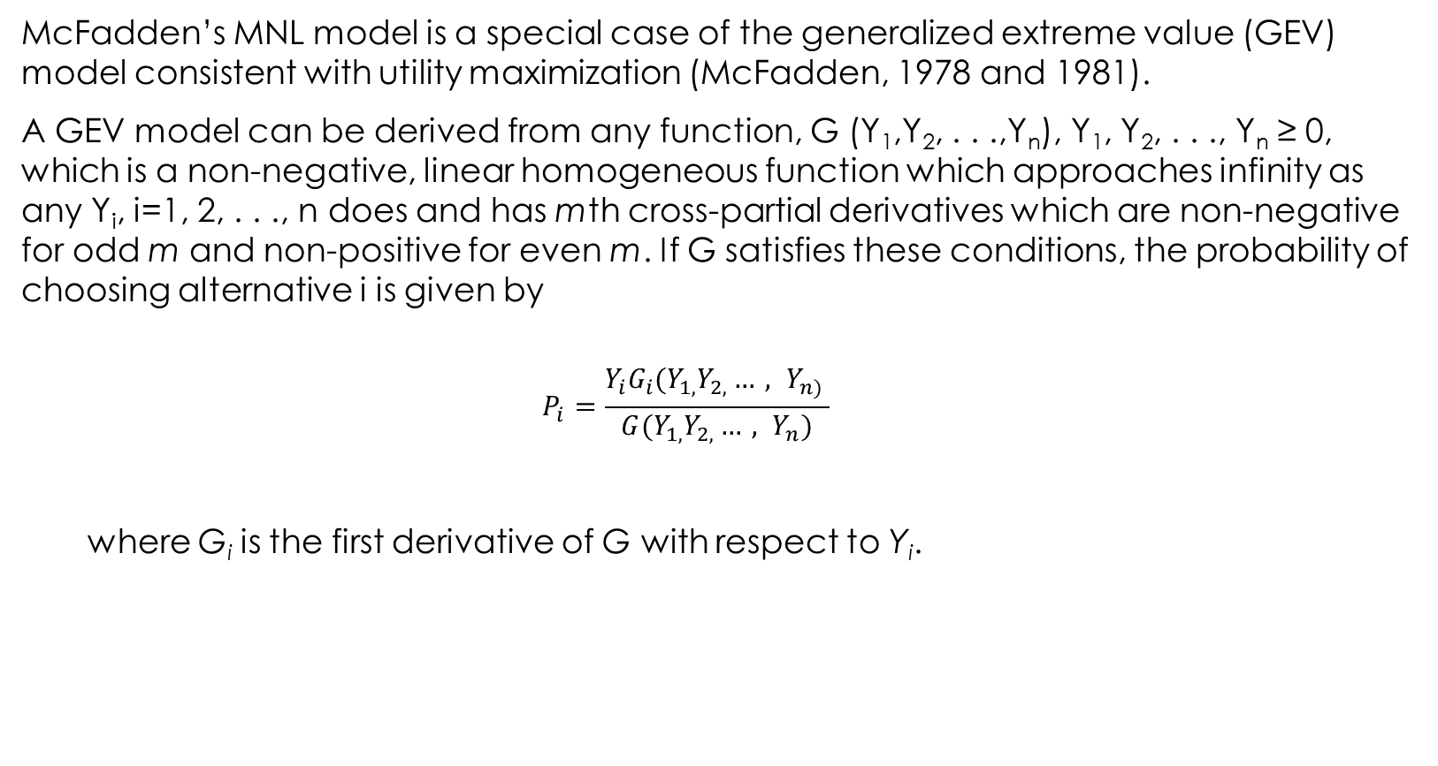
Nested MNL model
McFadden’s MNL model is a special case of the generalized extreme value (GEV) model consistent with utility maximization (McFadden, 1978 and 1981).
A GEV model can be derived from any function, G (Y₁,Y₂, . . .,Y_{n}), Y₁, Y₂, . . ., Y_{n} ≥ 0, which is a non-negative, linear homogeneous function which approaches infinity as any Y_{i}, i=1, 2, . . ., n does and has mth cross-partial derivatives which are non-negative for odd m and non-positive for even m. If G satisfies these conditions, the probability of choosing alternative i is given by
$$P_{i}=\frac{Y_{i}{G_{i}(Y_{1,}Y_{2,}{…, Y}_{n)}}_{ }}{G(Y_{1,}Y_{2,}…, Y_{n})}$$
where G_{i} is the first derivative of G with respect to Y_{i}.
Notes:
To study the second objective of this paper the multinomial logit (MNL) model is used. MNL model proposed by McFadden is used to model the choice of one among a set of mutually exclusive alternatives (1973). This discrete choice model is based on the principles of utility maximization and has advantages of ease of estimation. However, this model has been criticized for its property known as the independence of irrelevant alternatives. Nested logit models developed later allow interdependence between pairs of alternatives in a common group (McFadden, 1978; Ben-Akiva and Lerman, 1985; Borsch-Supan, 1990).
McFadden’s MNL model is a special case of the generalized extreme value (GEV) model consistent with utility maximization (McFadden, 1978 and 1981). A GEV model can be derived from any function, G (Y₁,Y₂, . . .,Y_{n}), Y₁, Y₂, . . ., Y_{n} ≥ 0, which is a non-negative, linear homogeneous function which approaches infinity as any Y_{i}, i=1, 2, . . ., n does and has mth cross-partial derivatives which are non-negative for odd m and non-positive for even m. If G satisfies these conditions, the probability of choosing alternative i is given by
$P_{i}=\frac{Y_{i}{G_{i}(Y_{1,}Y_{2,}{…, Y}_{n)}}_{ }}{G(Y_{1,}Y_{2,}…, Y_{n})}$
where G_{i} is the first derivative of G with respect to Y_{i}. A two-level MNL model is obtained from
the G function
$G\left(Y_{1,}Y_{2, …, }Y_{n}\right)= \sum_{m=1}^{M}{(\sum_{nεN_{m}}{Y_{n}^{\frac{1}{μ_{n}}})^{μ_{m}}}}$
where N_{m} is the set of alternatives in nest m and μ_{m} is an index of the dissimilarity of alternatives
included in nest m. The MNL model is consistent with utility maximization if the conditions, 0 < μ_{m} ≤ 1, are satisfied for all μ_{m}. If μ_{m} =1 for all m, the NL collapses to the MNL.
To ensure positive Y_{i}, the transformation Y_{i} = exp (V_{i}) is adopted, where V_{i} represents the observable components of the utility for each alternative (U_{i} = V_{i} + ε_{i}, i=1, 2, . . ., n). The probability that alternative n is chosen can be written as
$P_{n}= P_{n/m}X P_{m}$
Where
$P_{n/m}=\frac{e^{{V_{n}}/{μ_{m}}}}{\sum_{n′εN_{m}}{e^{{V_{n′}}/{μ_{m}}}}}$
$P_{m}=\frac{e^{μ_{m}Г_{m}}}{\sum_{m′=1}^{M}{e^{{μ_{m′}}/{Г_{m′}}}}}$
And
$Г_{m}=$ ln $\sum_{n′εN_{m}}{e^{{V_{n′}}/{μ_{m}}}}$
V_{n} is the utility associated with alternative n in nest m, P_{n/m} is the conditional probability of
choosing alternative n conditional on choosing nest m, P_{m} is the marginal probability of choosing
nest m of which n is a member; N_{m} is the set of all alternatives included in nest m, Г_{m} is the logsum variable of nest m* and μ_{m} is the logsum or inclusive value (IV) parameter. Thus, V_{m}, the utility of nest m is equal to μ_{m} Г_{m}.
Maximum likelihood techniques are used to estimate parameters of the MNL model. The log-likelihood for discrete outcomes is of the form
$L=\sum_{q}{\sum_{i}{δ_{qi}}}lnP_{qi}$
Where δ_{qi} is 1 if individual q chooses alternative i and 0 otherwise, P_{qi} is the probability that individual q chooses alternative i.

Slide 14
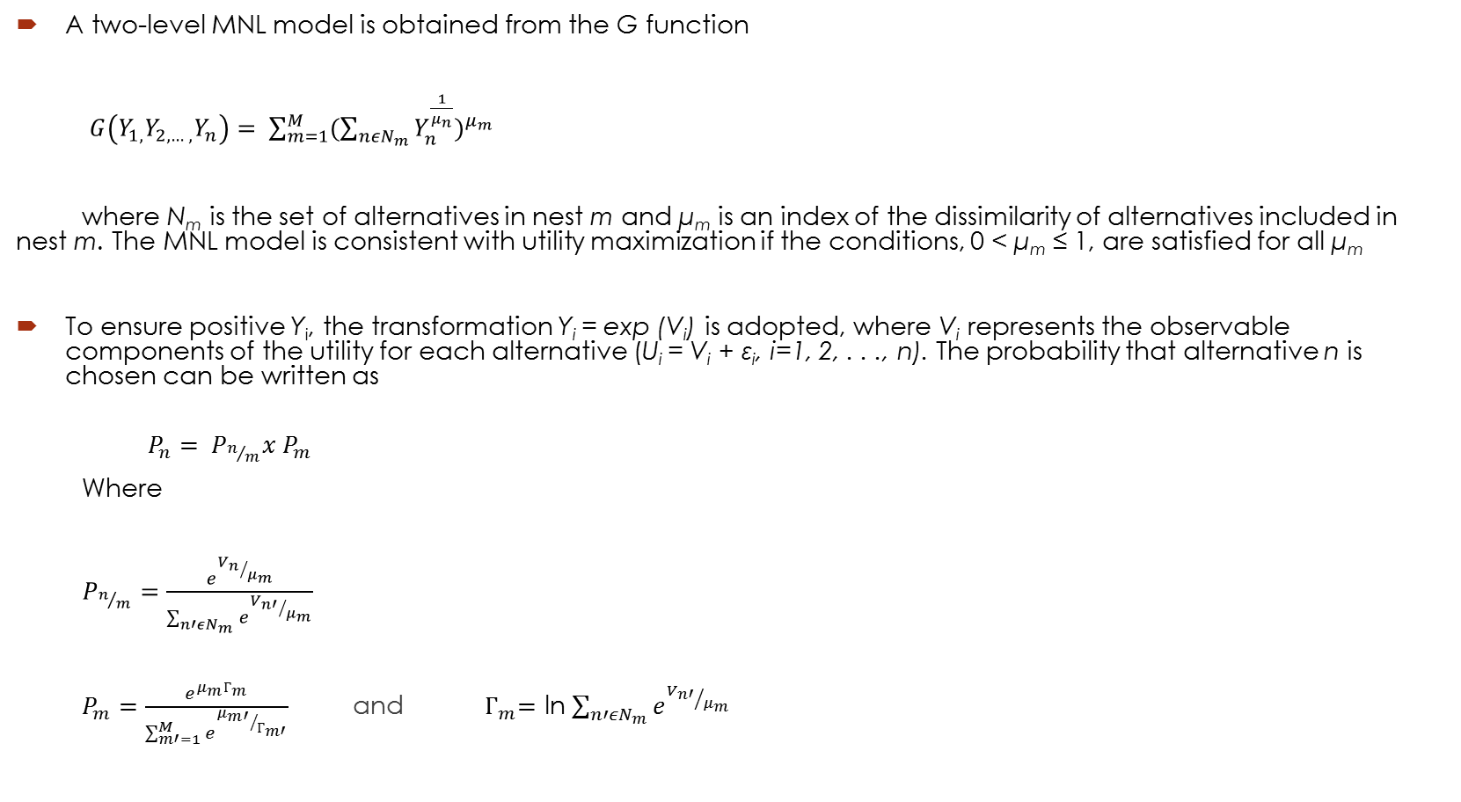
Nested Logit Model
A two-level MNL model is obtained from the G function
$G\left(Y_{1,}Y_{2, …, }Y_{n}\right)= \sum_{m=1}^{M}{(\sum_{nεN_{m}}{Y_{n}^{\frac{1}{μ_{n}}})^{μ_{m}}}}$
where N_{m} is the set of alternatives in nest m and μ_{m} is an index of the dissimilarity of alternatives included in nest m. The MNL model is consistent with utility maximization if the conditions, 0 < μ_{m} ≤ 1, are satisfied for all μ_{m}
To ensure positive Y_{i}, the transformation Y_{i} = exp (V_{i}) is adopted, where V_{i} represents the observable components of the utility for each alternative (U_{i} = V_{i} + ε_{i}, i=1, 2, . . ., n). The probability that alternative n is chosen can be written as
$P_{n}= P_{n/m}x P_{m}$
Where
$P_{n/m}=\frac{e^{{V_{n}}/{μ_{m}}}}{\sum_{n′εN_{m}}{e^{{V_{n′}}/{μ_{m}}}}}$
$P_{m}=\frac{e^{μ_{m}Г_{m}}}{\sum_{m′=1}^{M}{e^{{μ_{m′}}/{Г_{m′}}}}}$ and ${ Г}_{m}=$ ln $\sum_{n′εN_{m}}{e^{{V_{n′}}/{μ_{m}}}}$
Notes:
Independence from Irrelevant Alternatives Property (IIA)
Succinctly stated, the IIA property states that for a specific individual the ratio of the choice probabilities of any two alternatives is entirely unaffected by the systematic utilities of any other alternatives. This property arises from the assumption in the derivation of the logit model that the error terms ε_{n} across individuals are independent. In other words, it is assumed that un-observed attributes (error terms) of alternatives are independent. In many cases this is an unrealistic assumption, and creates some difficulties. For example, if driver n has an unobserved (error term) preference for public transit, then public transit mode error terms will not be independent.
Another way to express IIA is that the ratio of choice probabilities of any two alternatives for a specific individual is entirely unaffected by the systematic utilities of any other alternatives.
Note that the ratio of probabilities of modes i and j for individual n are unaffected by ‘irrelevant’ alternatives in C_{n}.

Slide 15
Nested Logit Model
Two-Levels decision tree
Choice
1 2 3 Level 2
1 2 3 4 5 6 7 8 9 10 11 12 Level 1
Notes:
2 level: 1 –domestic, 2 – imported, 3 assorted
1 level:
Under 1:1-dom ale, 2-dom lager, 3 –dom stout, 4-dom porter, 5-dom malt, 6-dom draft
Under 2:7-imp ale, 8-omp lager, 9-imp stout, 10-imp porter, 11-imp malt
Under 3: 12 assorted beer.

Slide 16
Nested Logit Model
Significance/insignificance of variables on the purchasing decision making
Choice probabilities for a set of alternatives
Notes:
Professor’ House. (2014) Popular Brands of Beer, http://www.professorshouse.com/Food-
Beverage/Beer/Articles/Popular-Brands-of-Beer/
McFadden, D. (1973) Conditional logit analysis of qualitative choice behavior. In Frontiers in
Econometrics, ed. P. Zarembka. Academic Press, New York.
McFadden, D. (1978) Modeling the choice of residential location. Transportation Research
Record 672, 72-77.
McFadden, D. (1981) Econometric models of probabilistic choice. In Structural Analysis of
Discrete Data, eds. C. F. Manski and D. McFadden. The MIT Press, Cambridge
MA. McFadden, 1973.
Ben-Akiva, M. and Lerman, S. R. (1985) Discrete Choice Analysis: Theory and Application to
Travel Demand. The MIT Press, Cambridge.
Bӧrsch-Supan, A. (1990) On the compatibility of nested logit models with utility maximization.
Journal of Econometrics 32, 371-387.

